Slide 1
Cardiovascular Disease
The Association With Diet
Presented by Robert (Bob) Ebend

Slide 2
Agenda
The Data Used
Hypothesis Test
Findings
Conclusions
Contact Information and Questions

Slide 3
The Data Used
308854 Rows, 19 Columns
Heart Disease *
Alcohol Consumption *
Fruit Consumption *
Green Vegetables Consumption *
Fried Potato Consumption *
Depression
Diabetes
Arthritis
Sex
Age Category
Height(cm)
Weight(kg)
BMI
Smoking History
Exercise
General Health
Checkup
Skin Cancer
Other Cancer
* Indicates columns used in Hypothesis Test
Notes:
-There were 12 categorical columns and 7 numeric columns.
-80 duplicate rows. Given the nature of the information and the small number of duplicates I left them in the analysis.
-I did have to change the data from categorical to numeric for the logical regression.

Slide 4
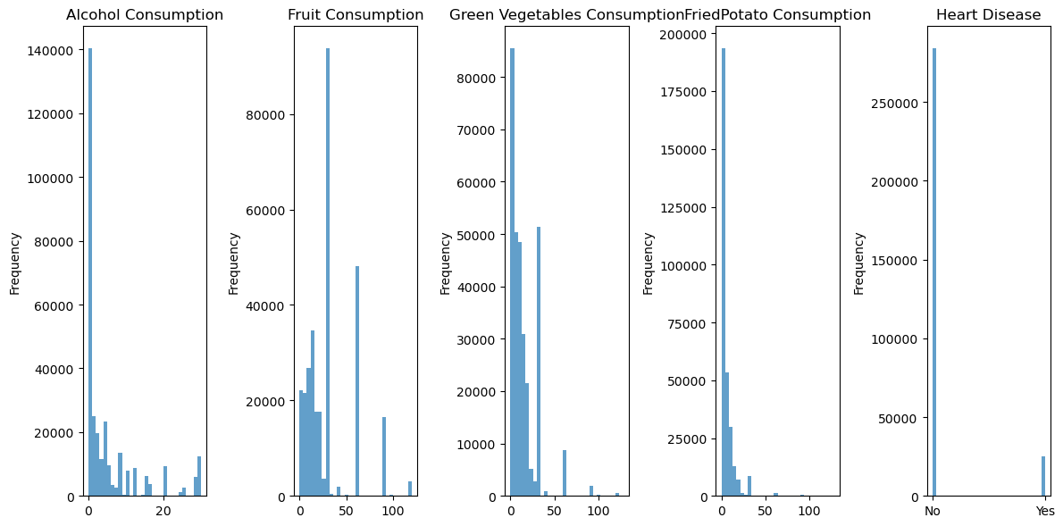
Histogram of Considered Features
283,883
24,971
Notes:
-As you can see these graphs are NOT Normally Distributed.
-Alcohol is an interesting graph due to the significant number of responses on the right of the y-axis
-Fruit is the only graph with a low zero count.

Slide 5
Hypothesis Question
Is there a significant association between the categories Alcohol, Fruit, Green Vegetable, Fried Potato Consumption and the presence of Heart Disease or not?
Notes:
- There is a strong statistical significance between the consumption features and heart disease.
* The Mann-Whitney U test was used for this test because it works well for non-normal distributions like in this dataset. It also works well comparing independent groups like Heart Disease and the Consumption features, and with large or small sample sizes

Slide 6
Hypothesis Answer
There IS a statistical significance with the categories Alcohol, Fruit, Green Vegetable, Fried Potato Consumption and the presence of Heart Disease.
Statistical significance does not necessarily mean important factor.
Notes:
- While there is a statistical significance between the consumption features and those with and without heart disease, they may not be reliable indicators for who will have heart disease solely based on their consumption patterns.
-This kind of situation is not uncommon in data analysis. Some variables might show statistical significance in isolation but might not hold strong predictive power when considered in the context of a more complex model. This is why it's important to consider multiple aspects of feature analysis, including statistical tests and predictive model results, to get a better understanding of how different factors contribute to the outcome
* The Mann-Whitney U test was used for this test because it works well for non-normal distributions like in this dataset. It also works well comparing independent groups like Heart Disease and the Consumption features, and with large or small sample sizes

Slide 7
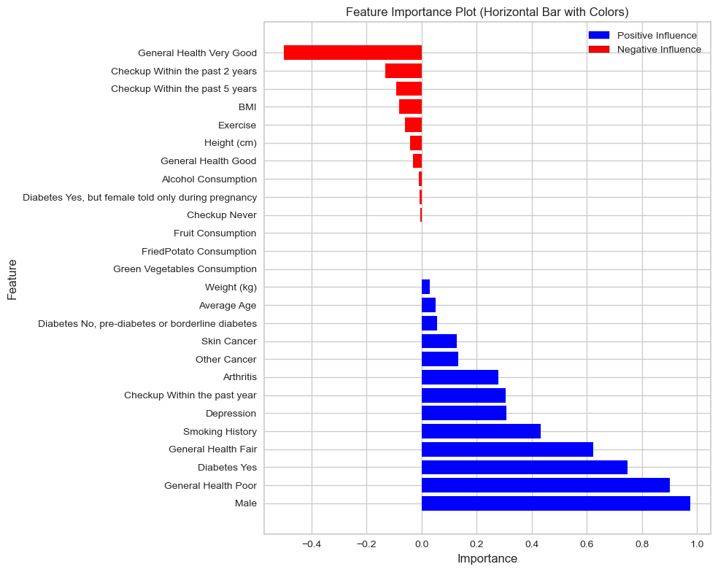
Feature Importance
Feature Importance does NOT imply Causation.
It only shows how the feature’s value relates to the predicted outcome
Longer Bar: Stronger Predictor
Shorter Bar: Weaker Predictor
*
*
*
*

Slide 8
Conclusion
What you consume does have a statistically significant impact on your Heart Disease risk.
What you consume is only a part of many factors playing a roll in overall health and disease prevention.
It is important to remember that while the features may have a significant relationship with Heart Disease this relationship does not imply causation.
This analysis is not intended to provide medical advice.

Slide 9
Contact Information and Questions
Presenter: Robert (Bob) Ebend
Email: robertebend@gmail.com
Repository Link: bobebend/Cardiovascular_diseases_risk_prediction (github.com)
Link to the Data: Cardiovascular Diseases Risk Prediction Dataset | Kaggle

Slide 10
Results for the Mann-Whitney U Test
Category Heart Disease Mann Whitney U P Value
Alcohol Consumption Yes 3.006144e+09 0.000000e+00
Fruit Consumption Yes 3.374578e+09 2.359073e-37
Green Vegetables Consumption Yes 3.340435e+09 3.777408e-52
Fried Potato Consumption Yes 3.368543e+09 1.863347e-39

Slide 11
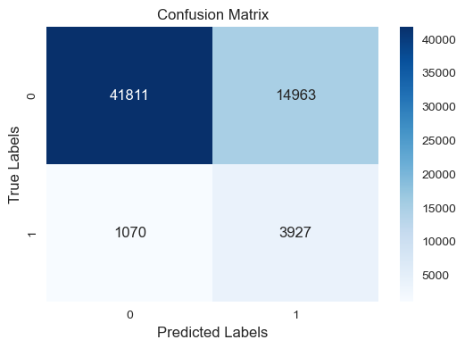
Logistic Regression Results
True Negative
False Positive
False Negative
True Positive
Notes:
True Positive (TP): This represents the cases where the model correctly predicted the positive class (e.g., presence of Heart Disease), and the actual outcome was indeed positive. In medical terms, this would be cases where the model predicted Heart Disease, and the person actually has Heart Disease.
True Negative (TN): These are the cases where the model correctly predicted the negative class (e.g., absence of Heart Disease), and the actual outcome was indeed negative. In medical terms, this would be cases where the model predicted no Heart Disease, and the person is indeed healthy.
False Positive (FP): These are the cases where the model predicted the positive class, but the actual outcome was negative. In other words, the model had a false alarm. In medical terms, this would be cases where the model predicted Heart Disease, but the person doesn't have it (a false positive prediction).
False Negative (FN): These are the cases where the model predicted the negative class, but the actual outcome was positive. This is a miss by the model. In medical terms, this would be cases where the model predicted no Heart Disease, but the person actually has it (a false negative prediction).

Slide 12
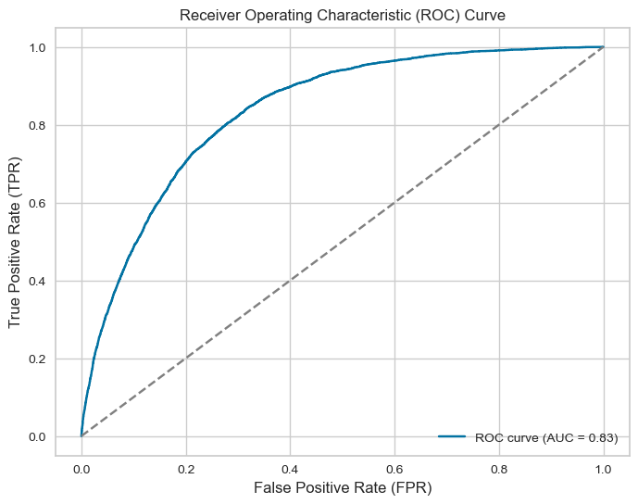
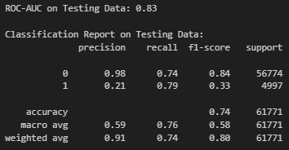
ROC Curve for Logistic Analysis

Slide 13
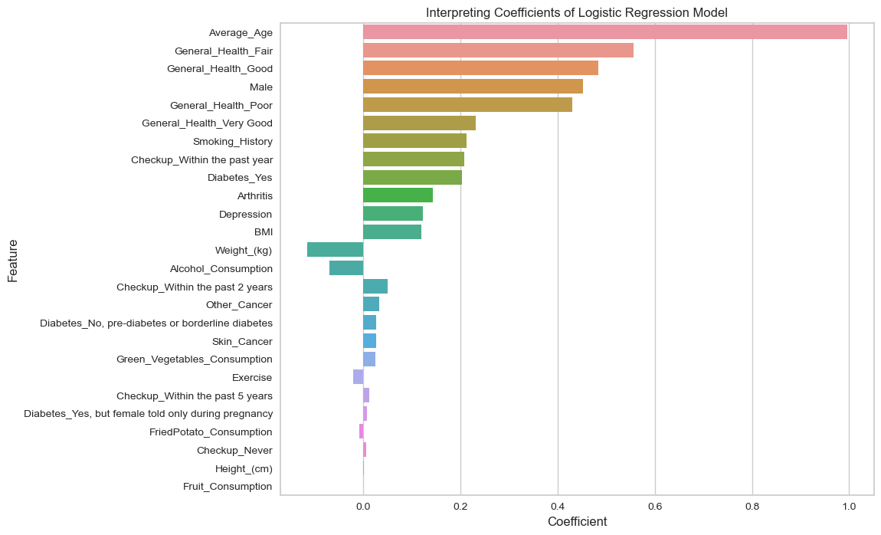
Interpreting Coefficients Plot
*
*
*
*

Slide 14
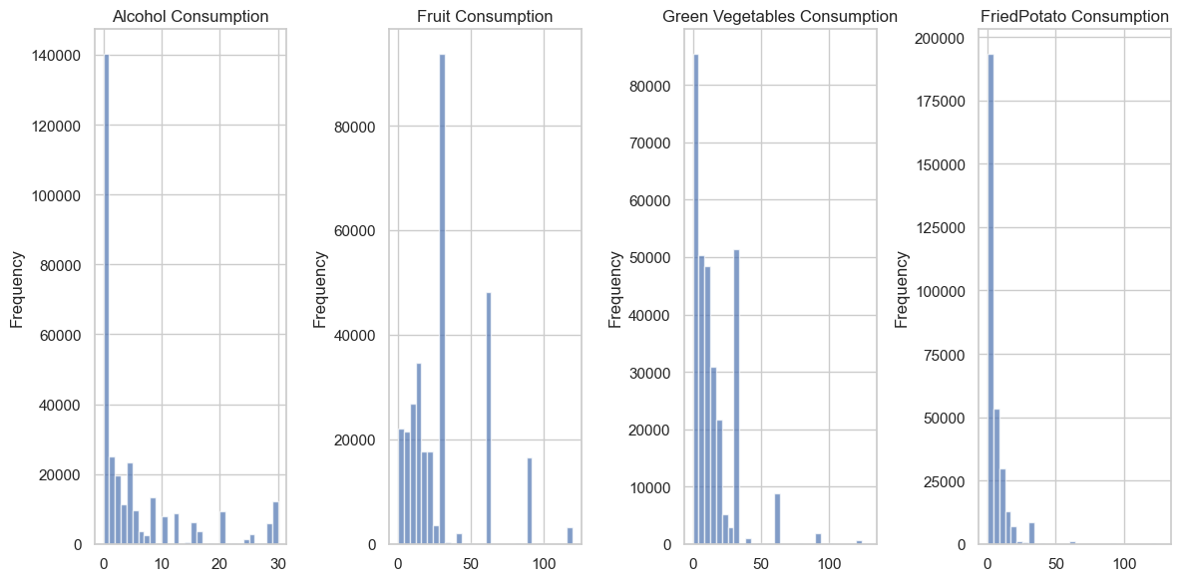
Histogram of Considered Features
Notes:
-As you can see these graphs are NOT Normally Distributed.
-Alcohol is an interesting graph due to the significant number of responses on the right of the y-axis
-Fruit is the only graph with a low zero count.

Slide 15
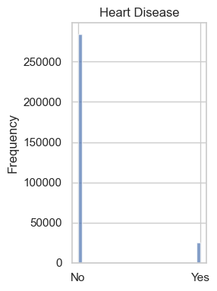
Four Categories and Heart Disease
Alcohol Consumption
Fruit Consumption
Green Vegetable Consumption
Fried Potato Consumption
283,883
24,971

